Slide 1
Dashboard Update #1

Slide 2
Agenda
Important Health Metrics to Track
Sample Dashboards from Other Sources
Analysis Thus Far
Work for the Duration of the Semester

Slide 3
Health Metrics To Consider Tracking
Our main areas of focus thus far
Utilization:
Percentage of Hours Covered
Churn Rate for Clients
Demographics:
Client Breakdowns based on school, major, class year, and first language
Writing Goals:
Most popular session goals
Can we predict client goals from past date?

Slide 4
Health Metrics To Consider Tracking
Problem: Different areas of need arise as a semester progresses, how can we best equip our tutors to handle this?
Potential Solution: Track which types of assignments (cover letters, research papers, etc) come in during the course of a given semester so that refresher materials can be sent out when appropriate.

Slide 5
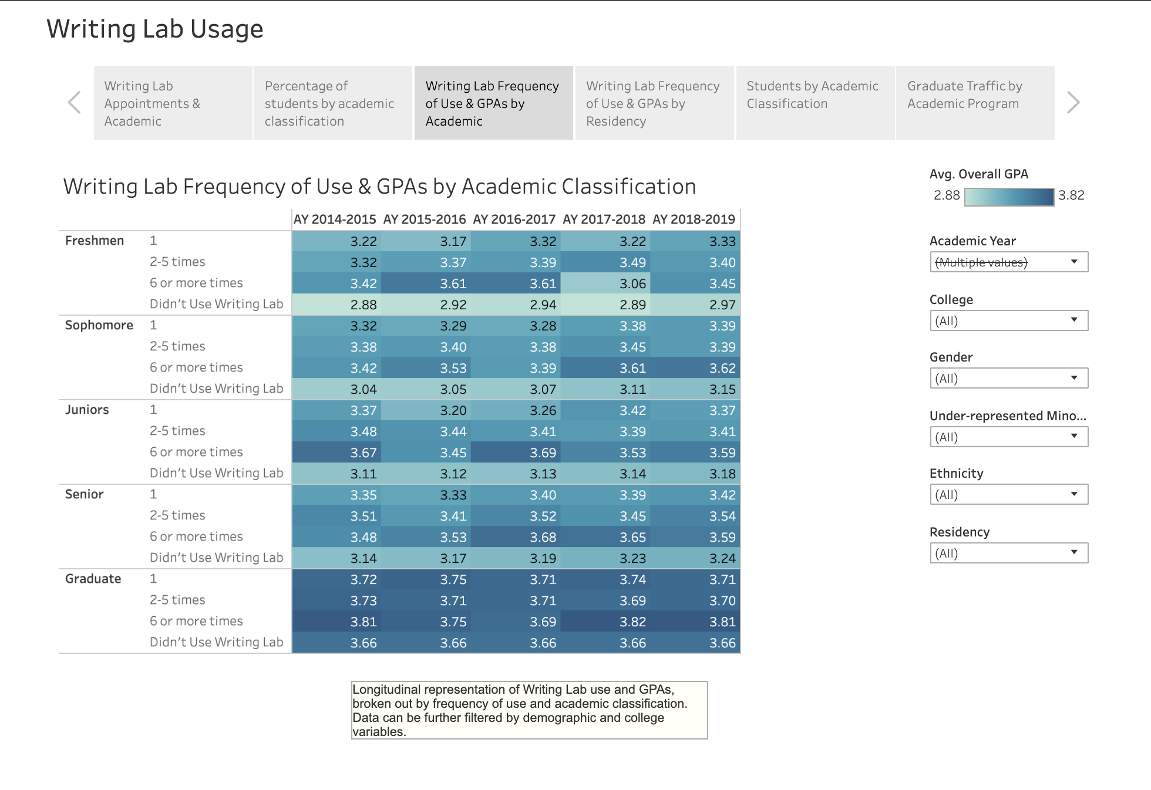
Sample Dashboards From Other Universities
Purdue's Writing Lab Tracks Writing Center Utilization and its Effect on GPA
Notes:
https://tableau.itap.purdue.edu/views/WLUsageAllStudentsVIS-WCOMatched2010-2018wStory/WritingLabUsage?iframeSizedToWindow=true&:embed=y&:showAppBanner=false&:display_count=no&:showVizHome=no&_ga=2.140413107.1404517649.1603384864-1147016000.1603384864

Slide 6

Sample Dashboards From Other Sources

Slide 7
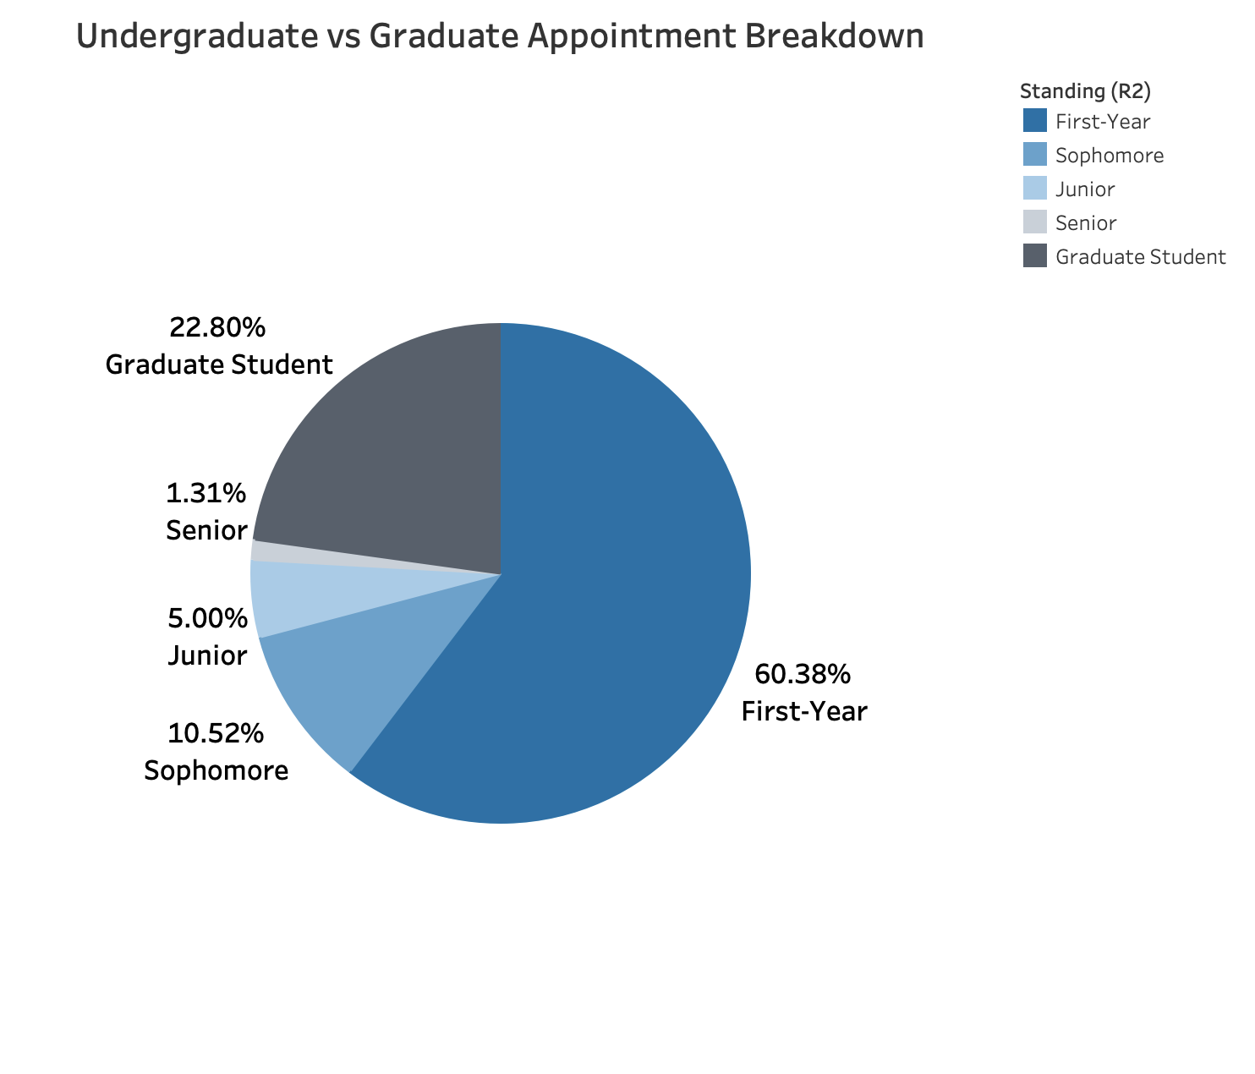
Analysis Thus Far

Slide 8

Analysis Thus Far

Slide 9
Analysis Thus Far

Slide 10
Analysis Thus Far

Slide 11
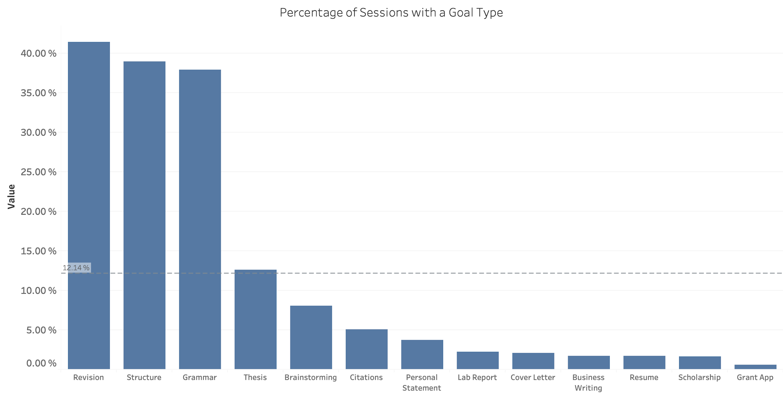
Analysis Thus Far

Slide 12
Work for Duration of the Semester
Gain increased familiarity with visualization software (Tableau)
Identification of Core Metrics to Calculate
Solid Design Idea Based on Core Metrics
Undertake Statistical Analysis and Forecasting using R to predict Center Demands into the Future (see: Time Series forecasting)

Slide 13
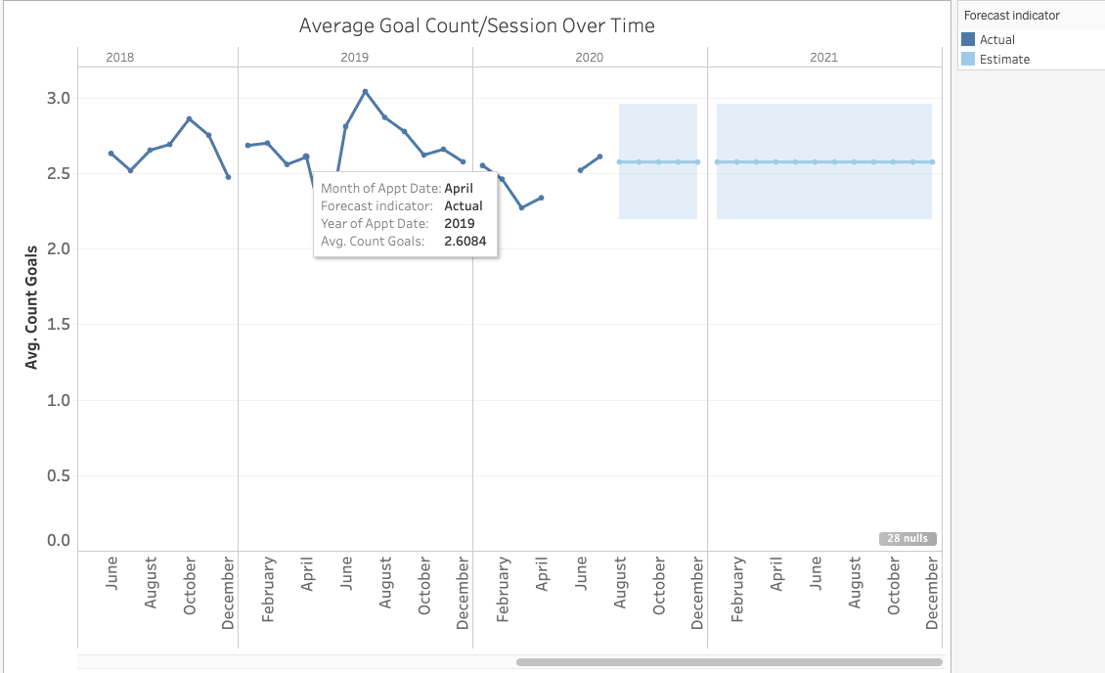
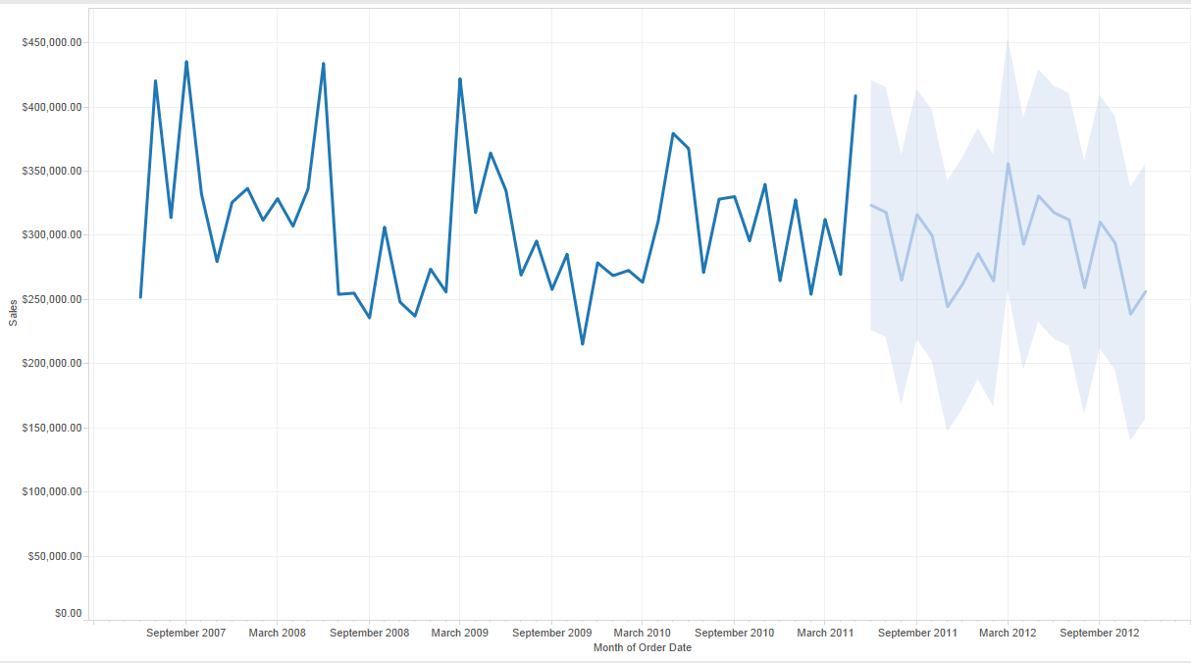
Work for Duration of the Semester
Notes:
Link:

